Slide 1
BLASTER: Characterizing the Blast Radius of Rowhammer
Zhenrong Lang Patrick Jattke Michele Marazzi Kaveh Razavi
ETH Zurich
3rd Workshop on DRAM Security (DRAMSec)
co-located with ISCA 2023
June 17, 2023

Slide 2
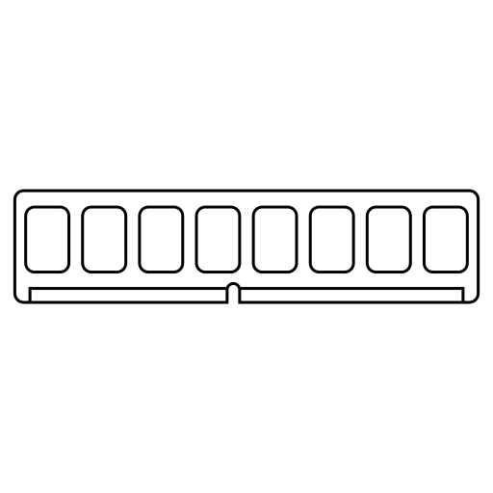




Summary
Blast radius has increased
Include up to eight aggressor rows
Demonstrate the effect of farther aggressors

Slide 3



Backgroud
DRAM organization
Rowhammer

Slide 4

Rowhammer Patterns
Far
Near
Victim
Near
Far
Half-Double [1]
Victim
Aggressor
Victim
Single-sided
Aggressor
Victim
Aggressor
Double-sided
Insight: an aggressor row can physically impact victim rows that are two rows away

Slide 5

Half-Double on DDR4
Half-Double was studied primarily on LPDDR4(x), which are more vulnerable to Rowhammer compared to DDR4 devices.
Question 1: To what extent do Half-Double patterns affect existing DDR4 DRAM devices?

Slide 6
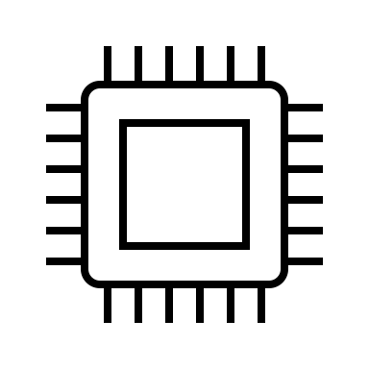

General Platform & Setup
Off-the-shelf consumer CPU
no fine-grained control over the exact commands sent
FPGA-based DRAM testing infrastructure (DRAM Bender) [2]
precise DDR4 commands
bypass CPU caches
disable DRAM refresh or Rowhammer mitigation
Three DDR4 UDIMMs from three different DRAM vendors
SK Hynix, Micron and Samsung

Slide 7

Determining the Hammer Count
Isolate the effects caused by near aggressors from those located farther away
HC* := maximum hammer count with no bit flips
Bound the number of activations to the near aggressors by a fraction of HC*

Slide 8

Half-Double on DDR4 DIMMs
Single-sided
Observation 1: probability to trigger a bit flip increases with higher ratio₂
ratio₁ × HC*
ratio₂
SK Hynix

Slide 9

BLASTER Patterns
The blast radius of an aggressor has expanded.
We introduce a new class of patterns, named BLASTER.
BLASTER extends beyond distance-2 aggressors.
Blast diameter
= 8 rows
Blast radius
= 4 rows
BLASTER patterns involve multiple aggressors positioned at various distances from the victim row.

Slide 10
Research Questions on BLASTER
Systematically examine the impact of far aggressor rows
Question 2: What is the effect of BLASTER patterns?

Slide 11
Characterizing BLASTER
Explore the parameter space of BLASTER patterns
Vary the overall amount of activations & of each aggressor
Question 3: How do varying activation ratios affect the victim row?
Far
Near
Near
Far

Slide 12
Effects of Distance-3 Aggressor Rows
Single-sided
Observation 2: bit flip probability grows by up to 50% when incorporating both aggressors R₂ and R₃
ratio₁ × HC*
ratio₂
ratio₃
Observation 3: activations of near aggressor R₁ can be further reduced by 30% (ratio₁ = 0.7)
Micron

Slide 13
Effects of Distance-3 Aggressor Rows
Double-sided
Observation 4: the effect of aggressor R₃ (R_{–3}) does not require aggressor R₂ (R_{–2}) to propagate to the victim row
Micron

Slide 14


Effects of Distance-4 Aggressor Rows
Single-sided
Observation 5: the probability of inducing bit flips mostly increases in patterns where ratio₁ is high
0.9 × HC*
4 4
ratio₄
1.0 × HC*
0
0
ratio₄
Samsung

Slide 15
Conclusion
Introduced BLASTER patterns, which involve multiple aggressors positioned at various distances from the victim row
Characterized the impact of BLASTER patterns on 24 commodity DRAM chips from the three major DRAM vendors
Showed future Rowhammer mitigations should consider aggressors up to four rows apart from a potential victim row

